Slide 1
Data Analysis Project-3
Amazon Sales Analysis
%
√
+
Prepared By – Madhumalinee Aryaratna

Slide 2
Contents of this Presentation
01
02
04
Introduction
Understanding the problem statement and the entire scenario of the project.
Understanding the data
Understanding the data which would be used for data analysis.
03
Data Pre Processing
Looking through data pre processing steps like data cleaning, dealing with outliers, missing values, duplicates, data transformation
x
Data Analysis- Insights (EDA)
%
100
Performing data analysis and getting insights regarding the situation.

Slide 3
01
Introduction
%
7
+
31
15
Understanding the problem statement and the entire scenario of the project.

Slide 4
Introduction
Sales management has gained importance to meet increasing competition and the need for improved methods of distribution to reduce cost and to increase profits. Sales management today is the most important function in a commercial and business enterprise.
Aim of this project
To analyze the sales of the amazon, understand the sales trend, find key metrics and factors and show the meaningful relationships between attributes.

Slide 5
02
Understanding the data
%
7
+
31
15
Understanding the data which would be used for data analysis.

Slide 6
Understanding the dataset
Dataset Link:
About Dataset
In the dataset, there are 14 columns- Region, Country, Item Type, Sales Channel, Order Priority, Order Date, Order ID, Ship Date, Units Sold, Unit Price, Unit Cost, Total Revenue, Total Cost, Total Profit.
Tools Used for Data Analysis
Python
2,500%

Slide 7
03
Data Pre-processing
%
7
+
31
15
Looking through data pre processing steps like data cleaning, dealing with outliers, missing values, duplicates, data transformation.

Slide 8
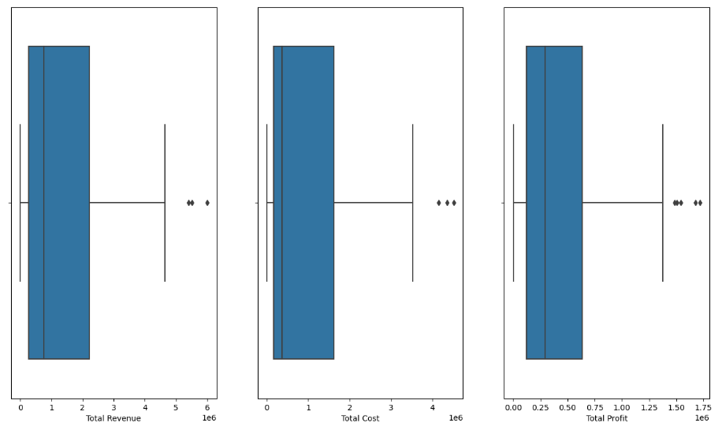
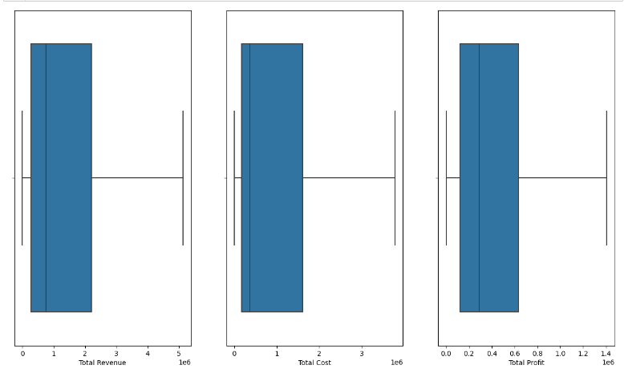
Data Pre- Processing
Dealing With Missing & Duplicate Values
There were no missing or duplicate values found the data set.
Dealing With Outliers
There are few outliers found in the total revenue column, total cost, and total profit columns, and the outliers are removed by the capping method using IQR method.

Slide 9
04
Data Analysis- Insights (EDA)
%
+
31
15
Performing data analysis and getting insights regarding the situation.

Slide 10
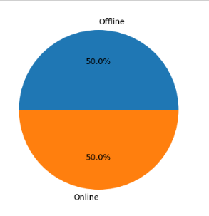
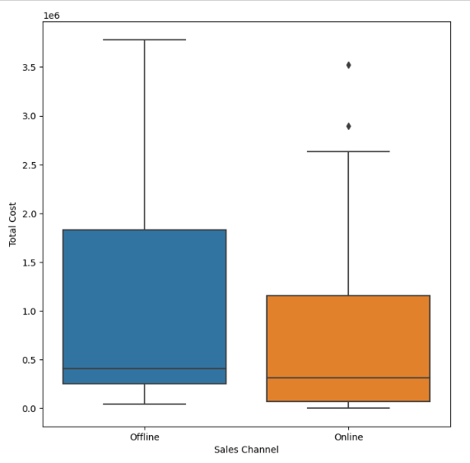
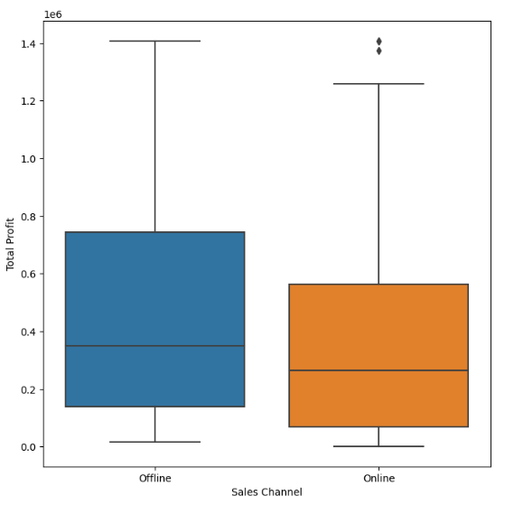
Insights On Sales Channel
Insights
Sales from both channels are same, there is no difference in the channels from which sales were coming.
Total cost incurred is high in the offline sales channel, and the total profit is also higher in the offline sales as compared to the online sales.

Slide 11
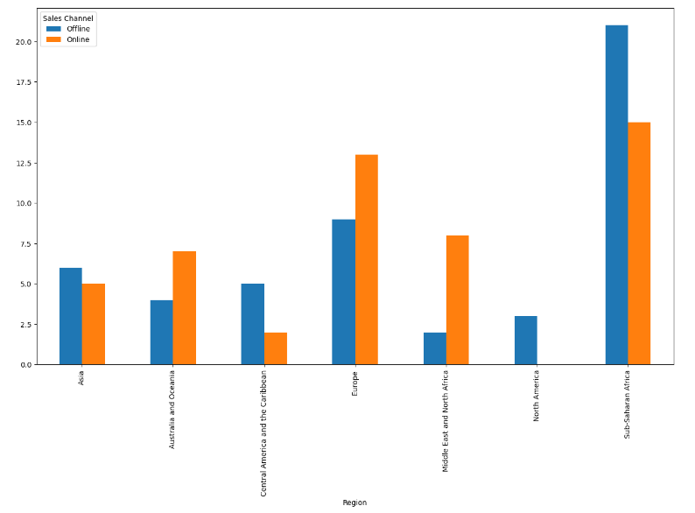
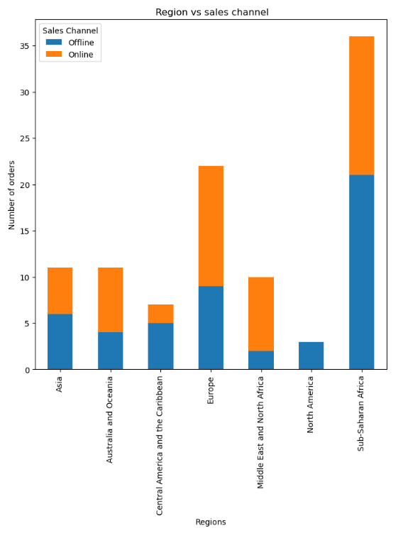
Insights On Sales Channel
Insights
These bar chart shows that maximum sales in both online and offline channels in Sub Saharan Africa.
After Sub Saharan Africa, sales is maximum in Europe.

Slide 12
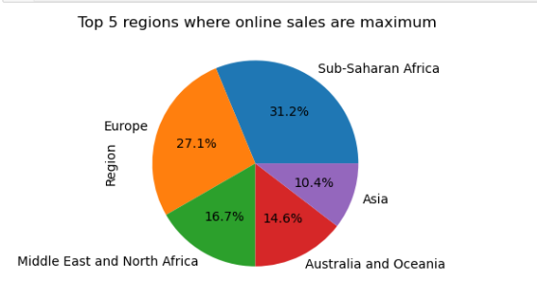
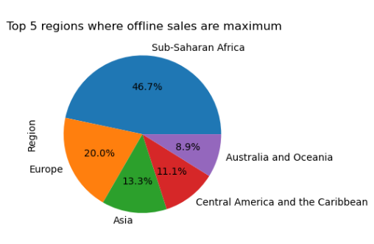
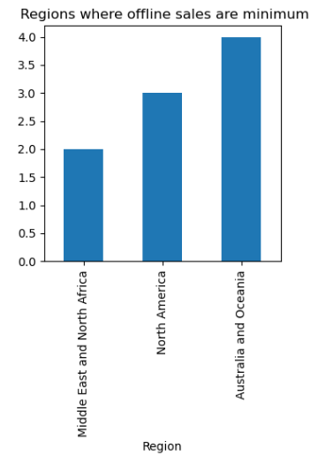
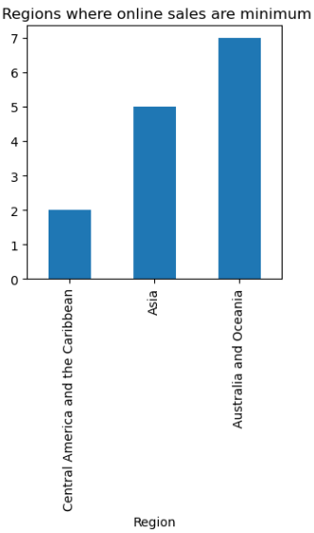
Insights On Sales Channel
Insights
The online sales is maximum in Sub Saharan Africa and Europe, and the other 2 top regions are Middle East and North Africa, Australia and Ocenia.
The offline sales is minimum in the Middle East & North Africa, North America, Australia and Ocenia.
The offline sales is maximum in Sub Saharan Africa, Europe, Asia, Central America, Australia.
The online sales is minimum in central America, Asia, Australia and Ocenia.

Slide 13
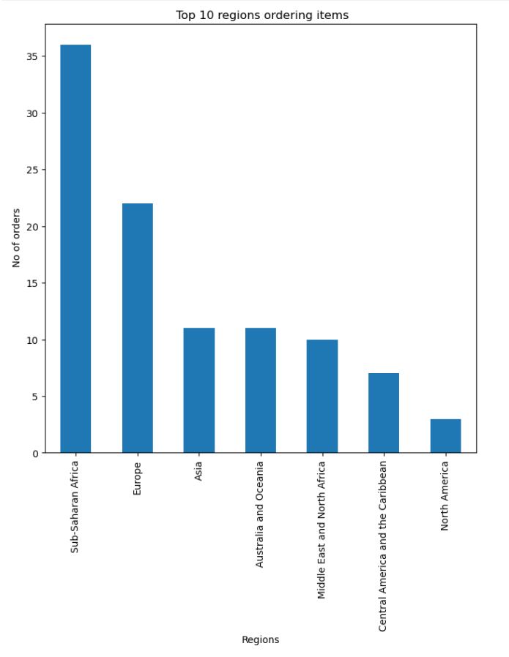
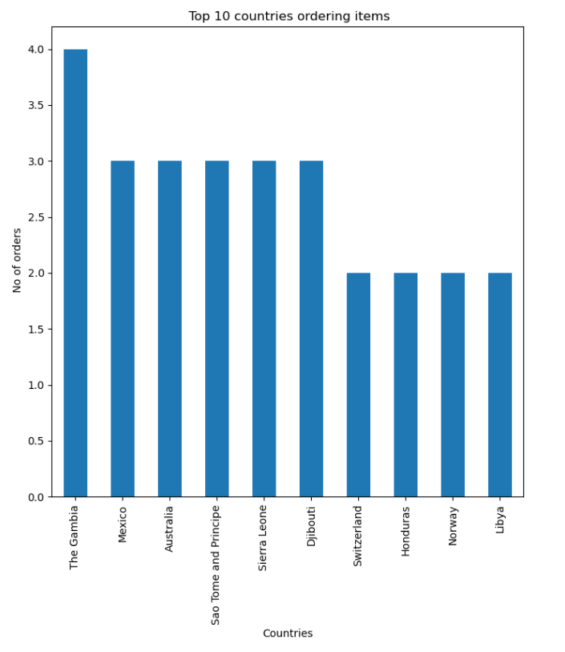
Insights On Sales Channel
Insights
The bar charts show Top 10 regions ordering items Sub Saharan Africa, Europe, Asia, Australia and Ocenia, Middle East and North Africa, Central America and Caribbean, and North America.
The bar charts shows Top 3 countries ordering items The Gambia, Mexico, Australia.

Slide 14
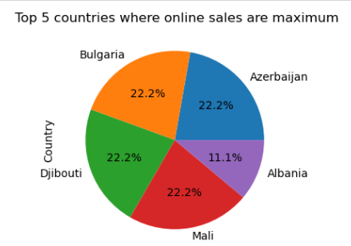
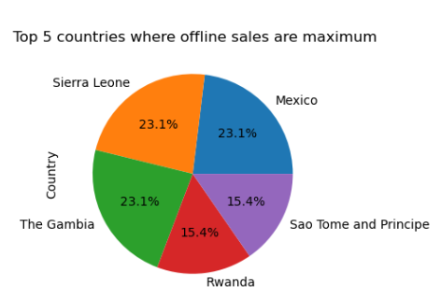
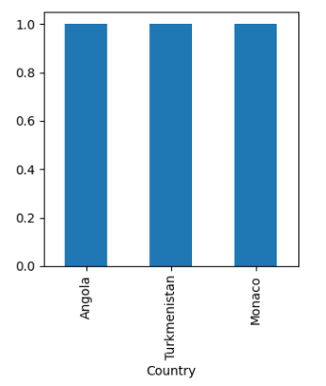
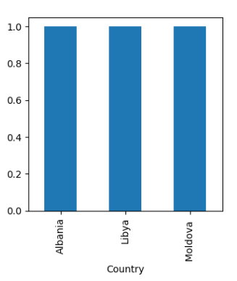
Insights On Country Wise Sales
Insights
The Top 5 countries where online sales are maximum are Azerbaijan, Bulgaria, Djibouti, Mali, Albania.
The Top 5 countries where offline sales are maximum are Mexico, Sierra Leone, Gambia, Rwanda, Sao Tome.
The Top 3 countries where offline sales are minimum are Angola, Turkmenistan, Monaco.
The top 3 countries where online sales are minimum are Albania, Libya, Moldova.

Slide 15
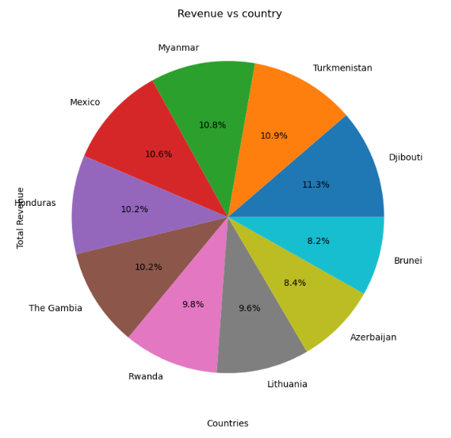
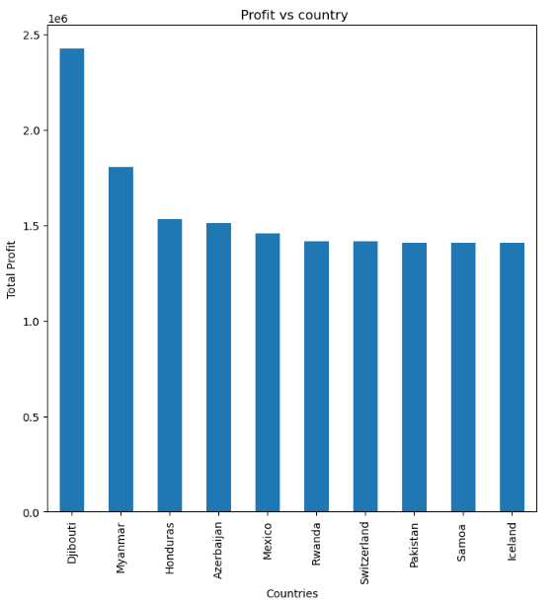
Insights On Country Wise Sales
Insights
Highest Revenue is coming from Djibouti among all the countries.
It is followed by Turkmenistan, Myanmar, Mexico, Honduras.
Most Profitable country is Djibouti, followed by Myanmar, Honduras, Azerbaijan.

Slide 16
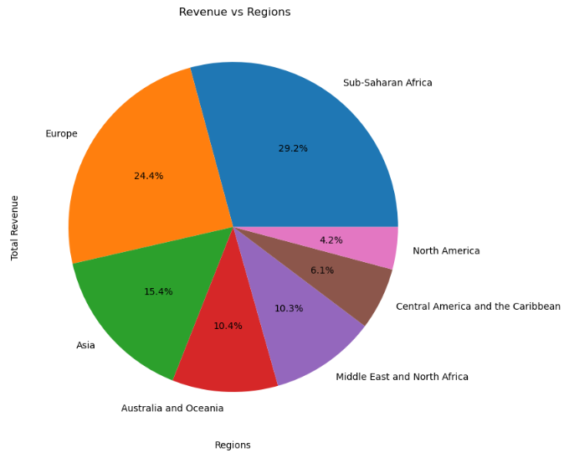
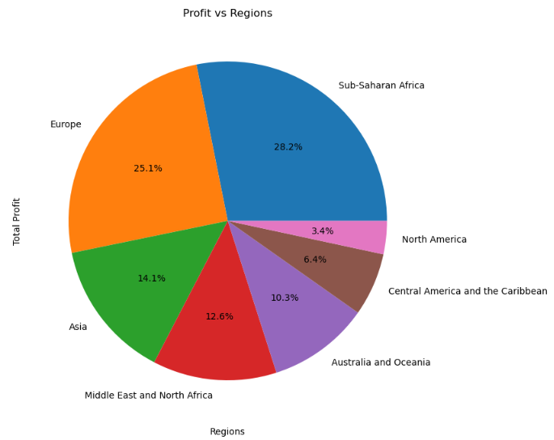
Insights On Region Wise Sales
Insights
The Sub Saharan Africa has the highest revenue and the highest profit among all the regions.
The North America has the lowest revenue and profits among all the regions.

Slide 17
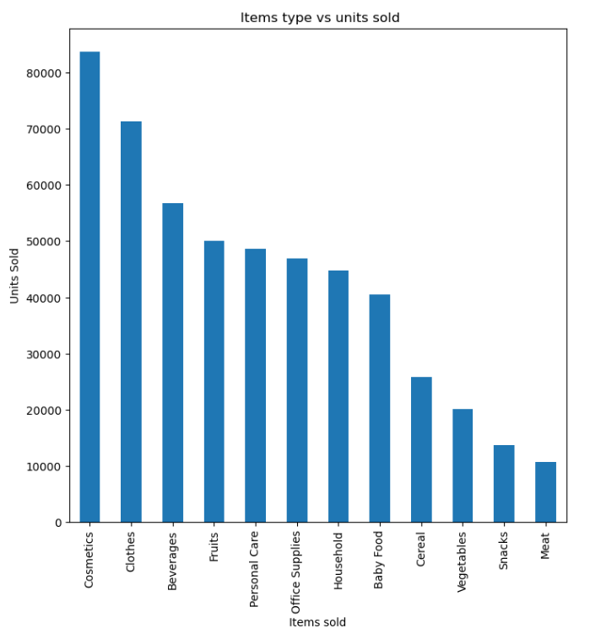
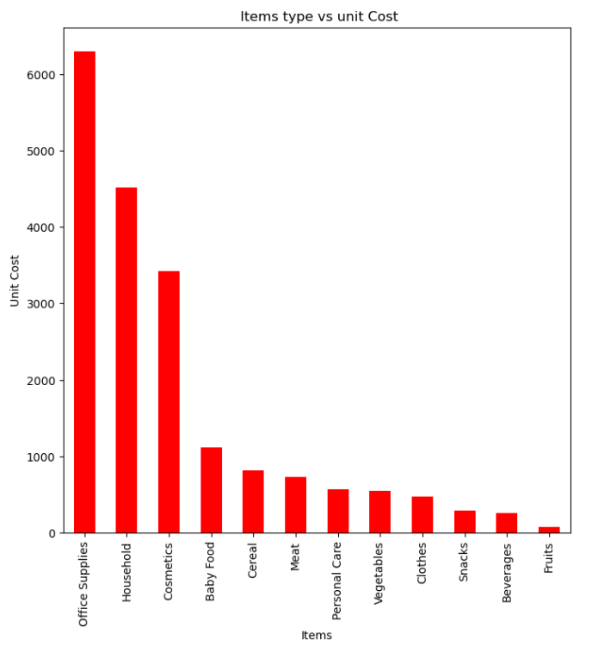
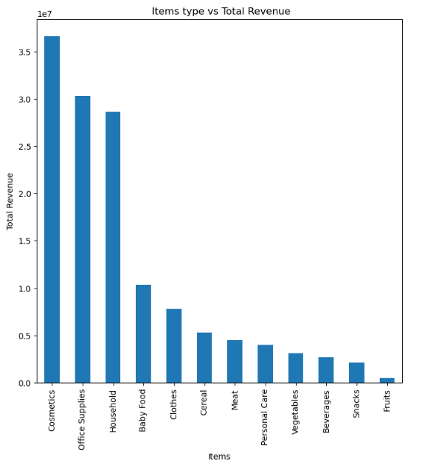
Insights On Item Types
Insights
The total products sold maximum are Cosmetics, Clothes, Beverages, Fruits in the order mentioned.
The products which are most cost incurring are office supplies, Households, Cosmetics, Baby food.
The products which are giving highest revenue are Cosmetics, Office Supplies, Household.

Slide 18
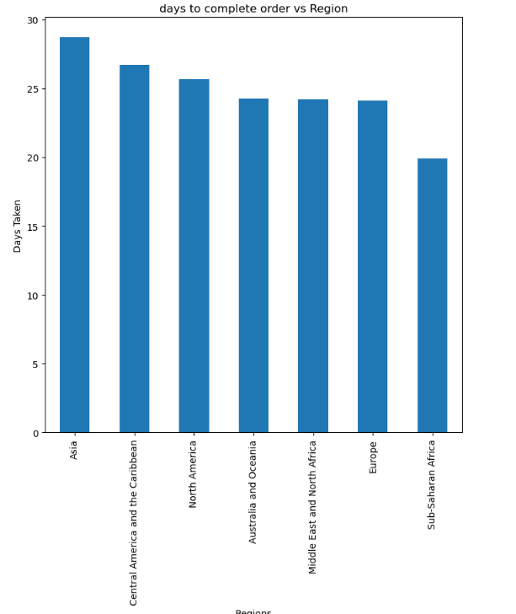
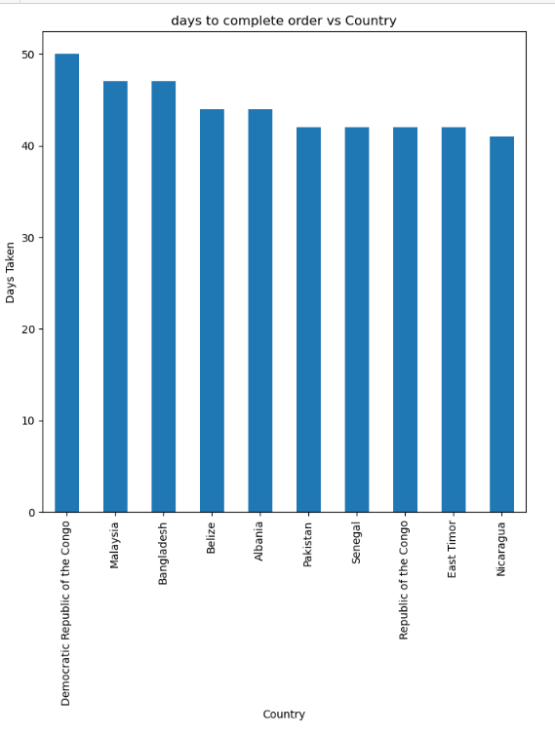
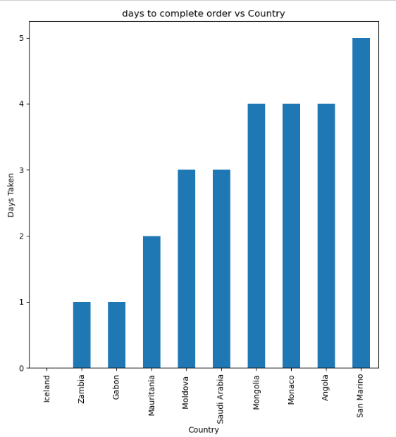
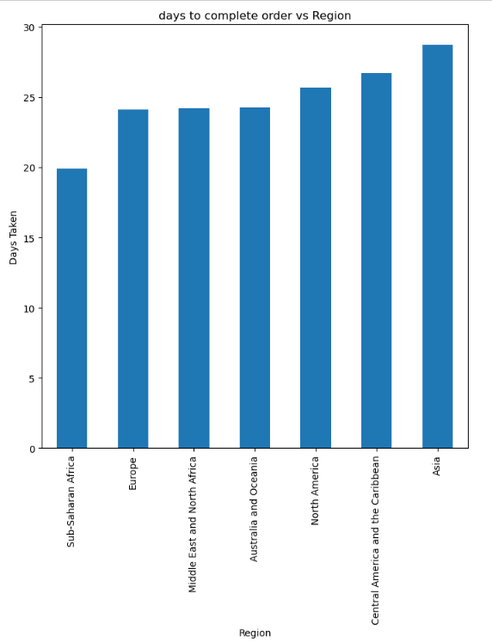
Insights On Days To Complete The Order
Insights
The regions where it is taking maximum days for completing an order are Asia, Central America and the Caribbean, Australia and Ocenia.
The regions where it is taking minimum days to complete an order are sub Saharan Africa, Europe, Middle and north Africa as the result may be the sales are more in these regions.
The countries where it is taking maximum days for completing an order are Congo, Malaysia, Bangladesh.
The countries where it is taking minimum days for completing an order are Iceland, Zambia, Gibbon.

Slide 19
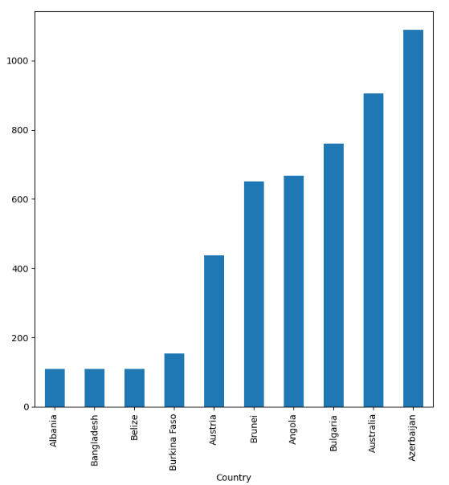
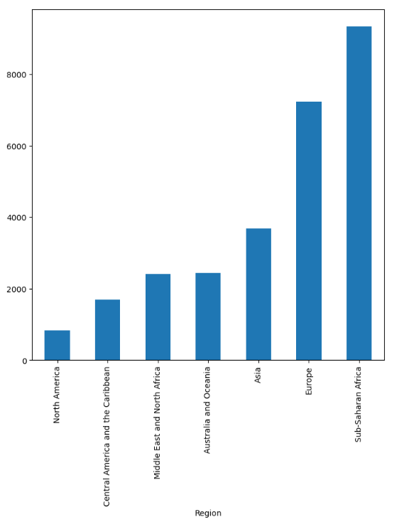
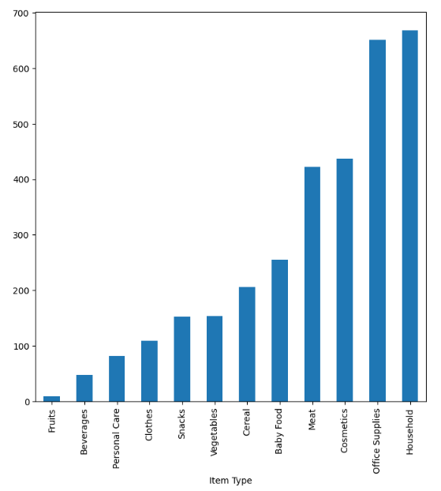
Insights On Cost Price
Insights
The countries where the unit prices of products are less, are Albania, Bangladesh, Belize.
The region where the unit prices are less, are North America, central America and the Caribbean.
The products where the unit prices are less are fruits, beverages, personal care and the prices which are highest are for cometics, office supplies and Household.

Slide 20
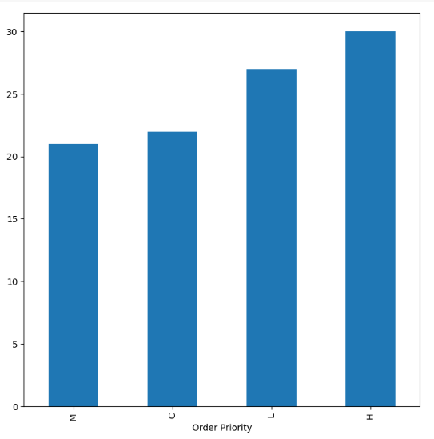
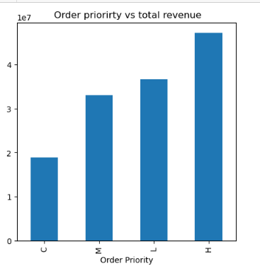
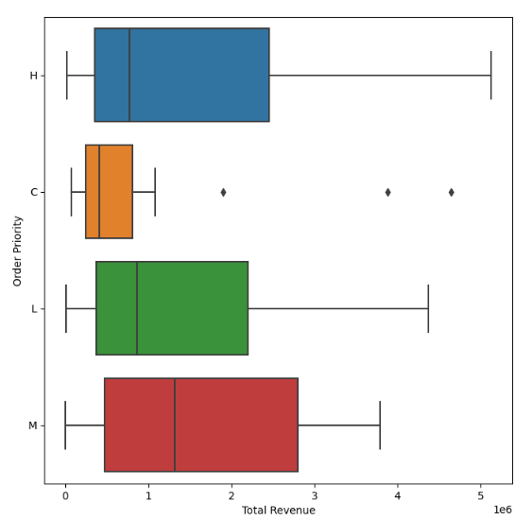
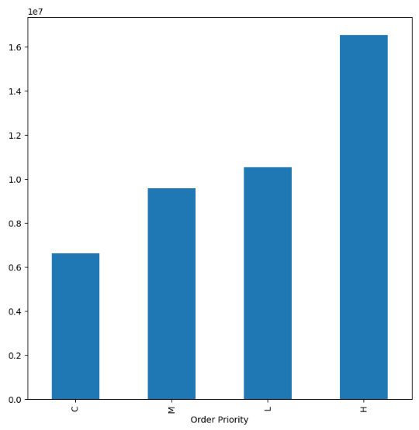
Insights On Order Priority
Insights
The highest number of orders received for High priority, and least order received by medium priority.
Highest total revenue is earned by High priority orders, and least by critical priority orders, which implies that very low price products are ordered in critical priority.
Highest profit is earned by high priority products, followed by low and medium and least profit is earned by critical order priority products.

Slide 21
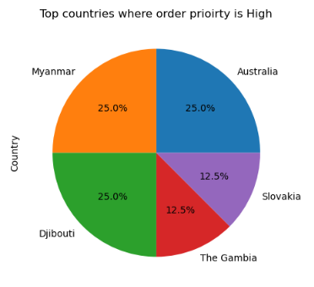
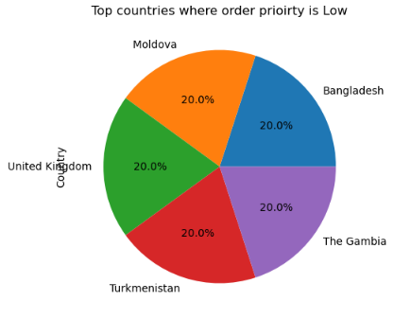
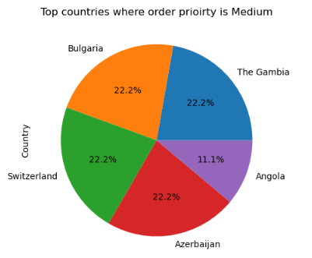
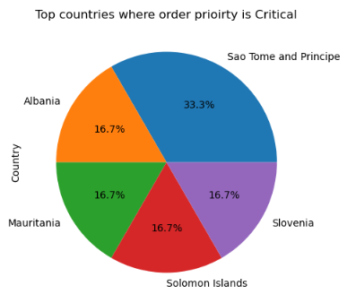
Insights On Order Priority
Insights
The countries where order priority are high : Australia, Myanmar, Djibouti, Gambia, Slovakia.
The countries where order priority are low : Bangladesh, Moldova, United Kingdom, Turkmenistan, Gambia.
The countries where order priority are Medium : Gambia, Bulgaria, Switzerland, Azerbaijan, Angola.
The countries where order priority are critical : Sao Tome and Principe, Albania, Mauritania, Soloman Islands, Slovenia.

Slide 22
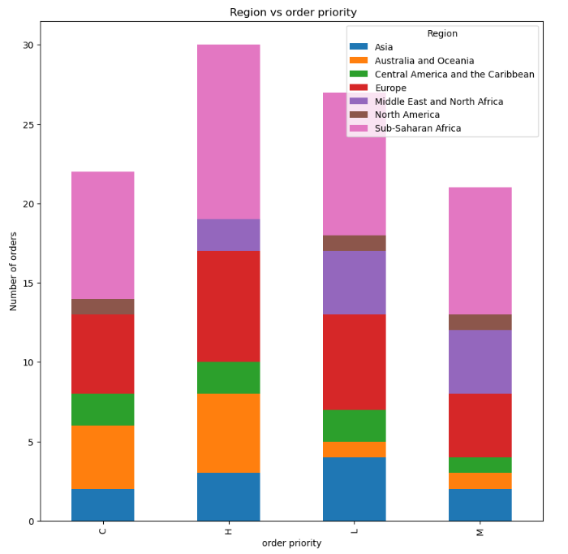
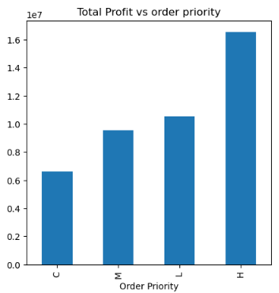
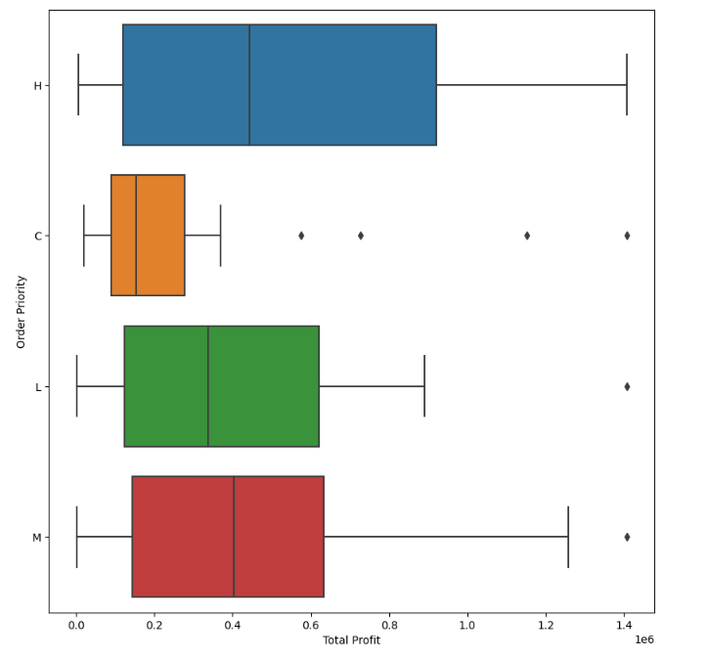
Insights On Order Priority
Insights
Total profit is maximum in the high priority orders, followed by low, medium and critical priority.
Most of the products for any of the priority, the highest region from which orders come is Sub Saharan Africa, and Europe.

Slide 23
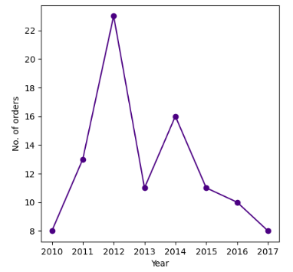
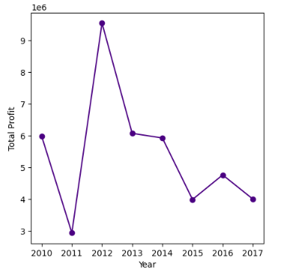
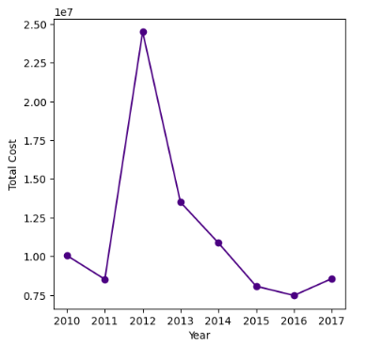
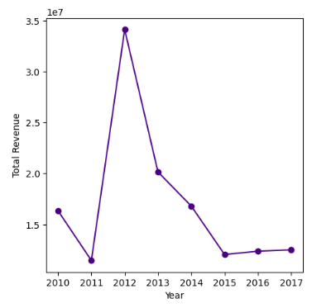
Insights On Trends
Insights
Total Profit has been on decrease since 2013, the highest profit is seen in the year 2012, and lowest profit is in the year 2011.
Total cost is showing a similar trend as total profit, the highest cost has been on decrease since 2012 and hitting lowest in 2016.
For revenue, similar trends were seen, there has been some issue since 2012, that a steep decline is seen in revenue, cost & profit.
The number of orders, total profit, total revenue has been on decline since 2012.

Slide 24
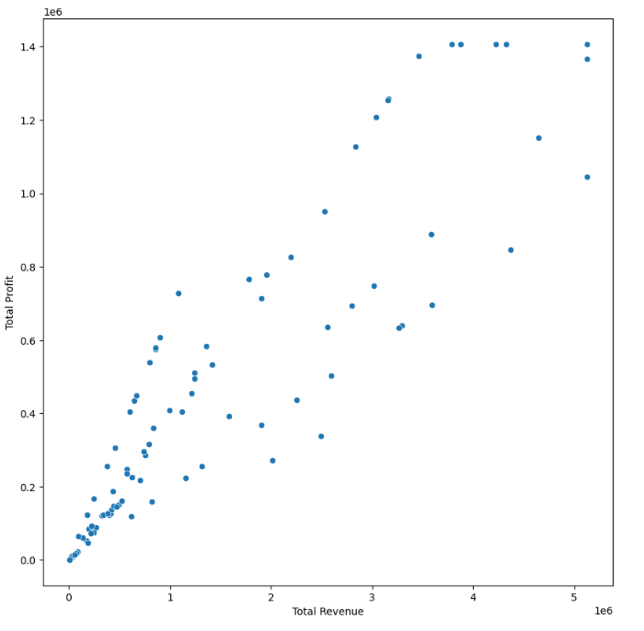
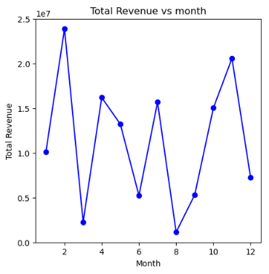
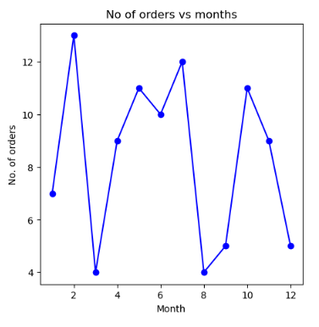
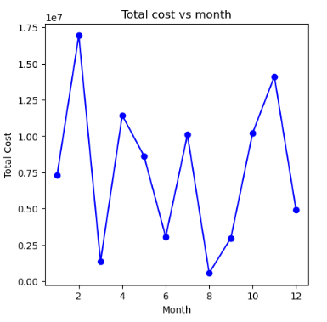
Insights On Trends
Insights
Total Profit is increasing with total revenue, which says that they are directly proportional to each other.
Total Revenue is highest in February, and lowest in august.
Total Orders are highest in February, which explains the high total revenue, and lowest august.
Total cost is highest in February, and lowest in august.

